Slide 1
Hostel booking website
Final exam assigment
Basic web development
NGUYEN TRONG GIA BAO
18020007

Slide 2
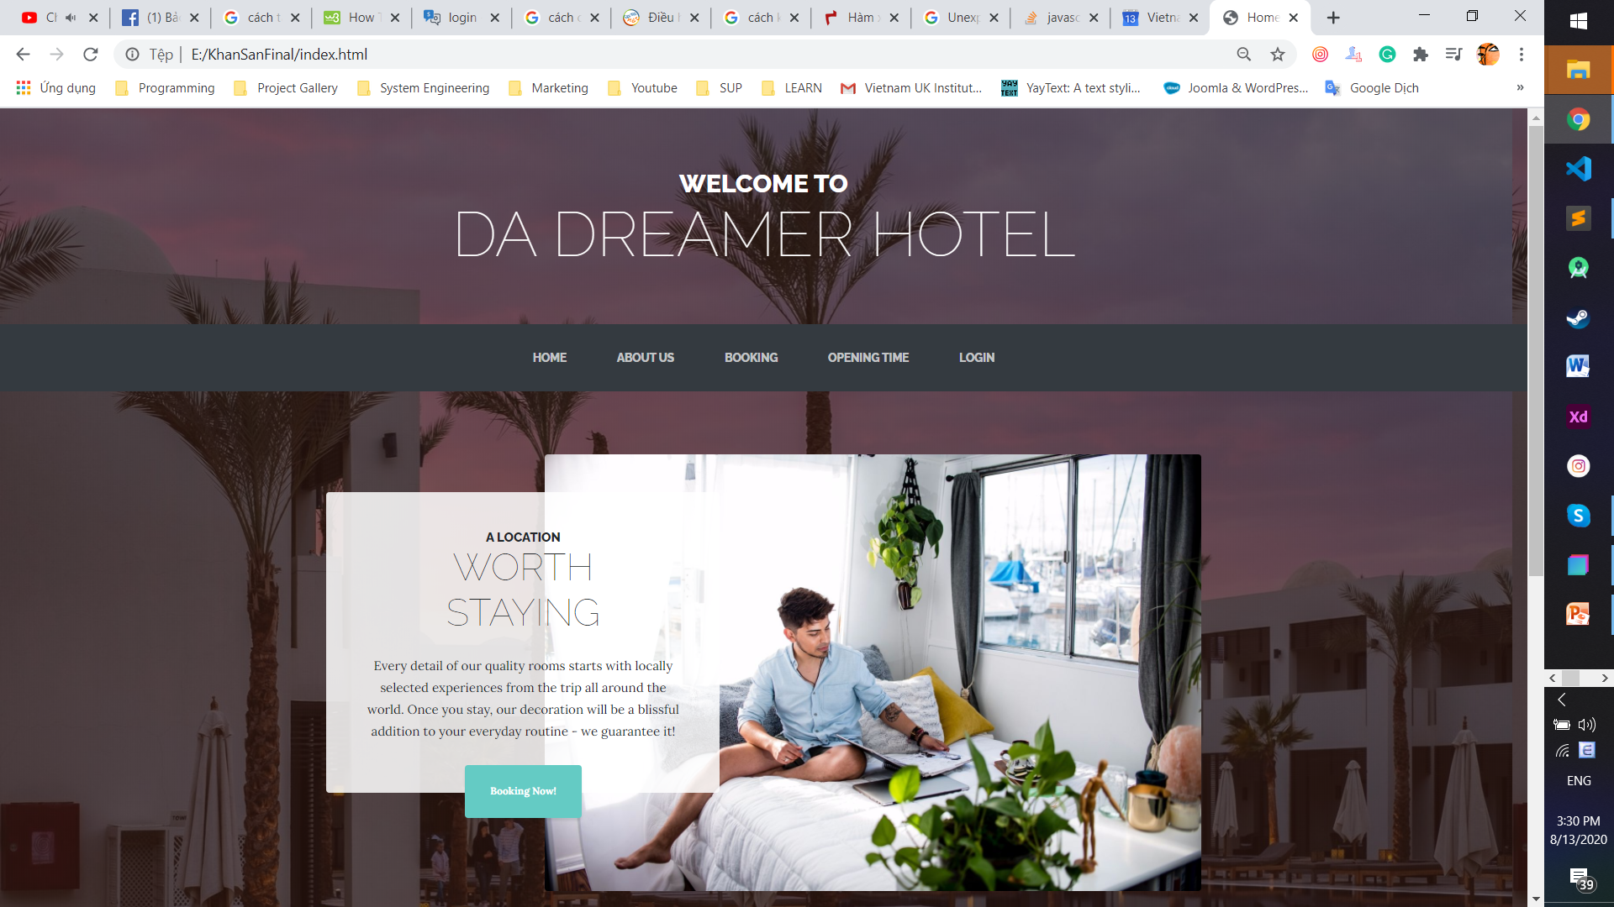
HOME PAGE

Slide 3
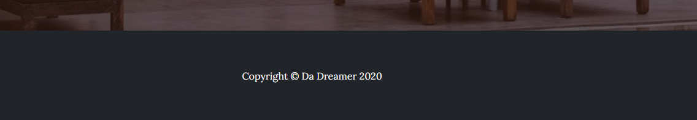
NAVIGATION BAR
BUTTON
FOOTER

Slide 4
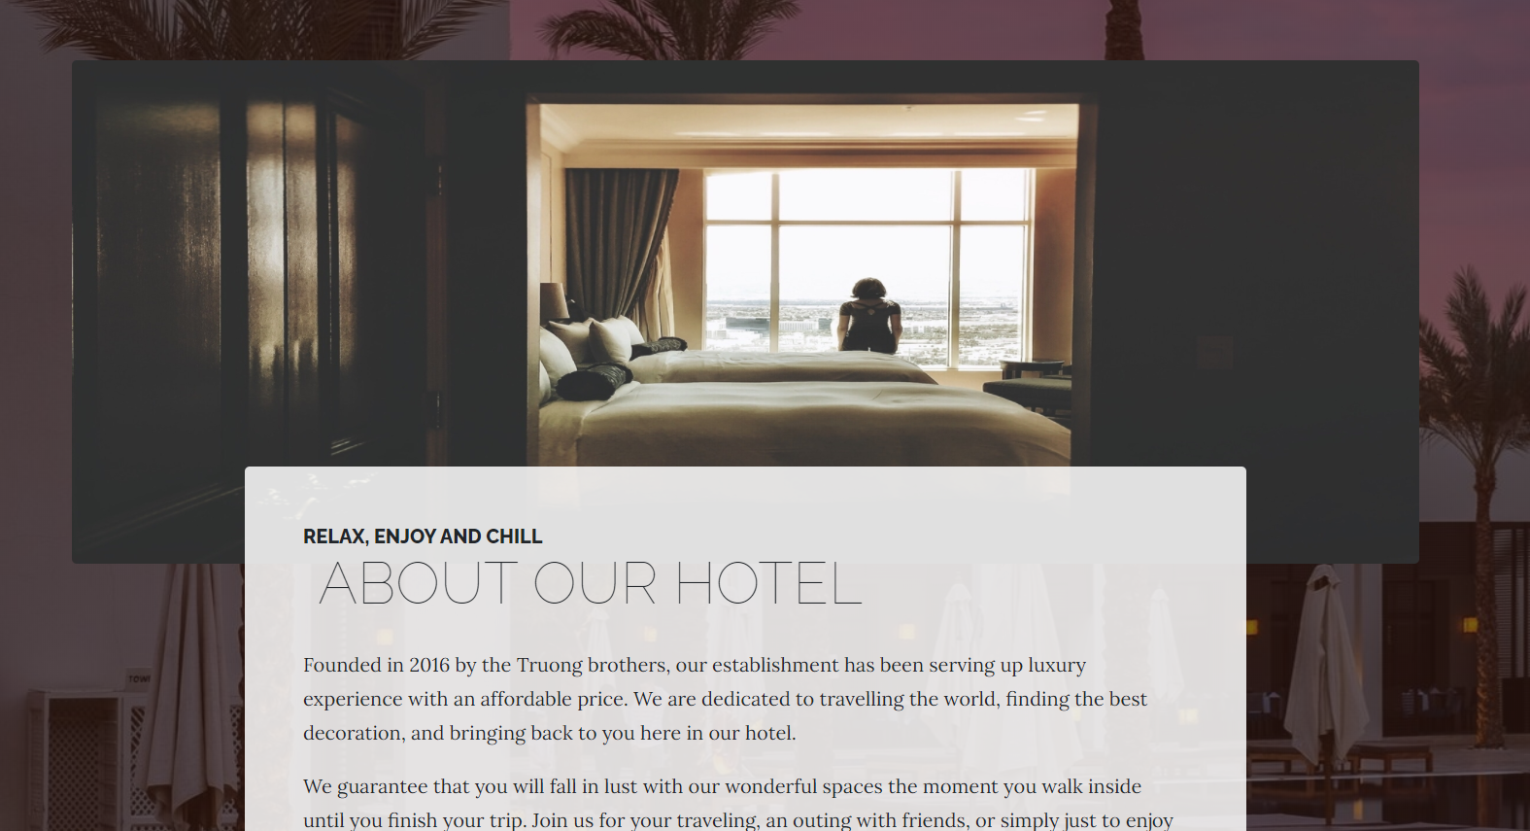
ABOUT US PAGE

Slide 5
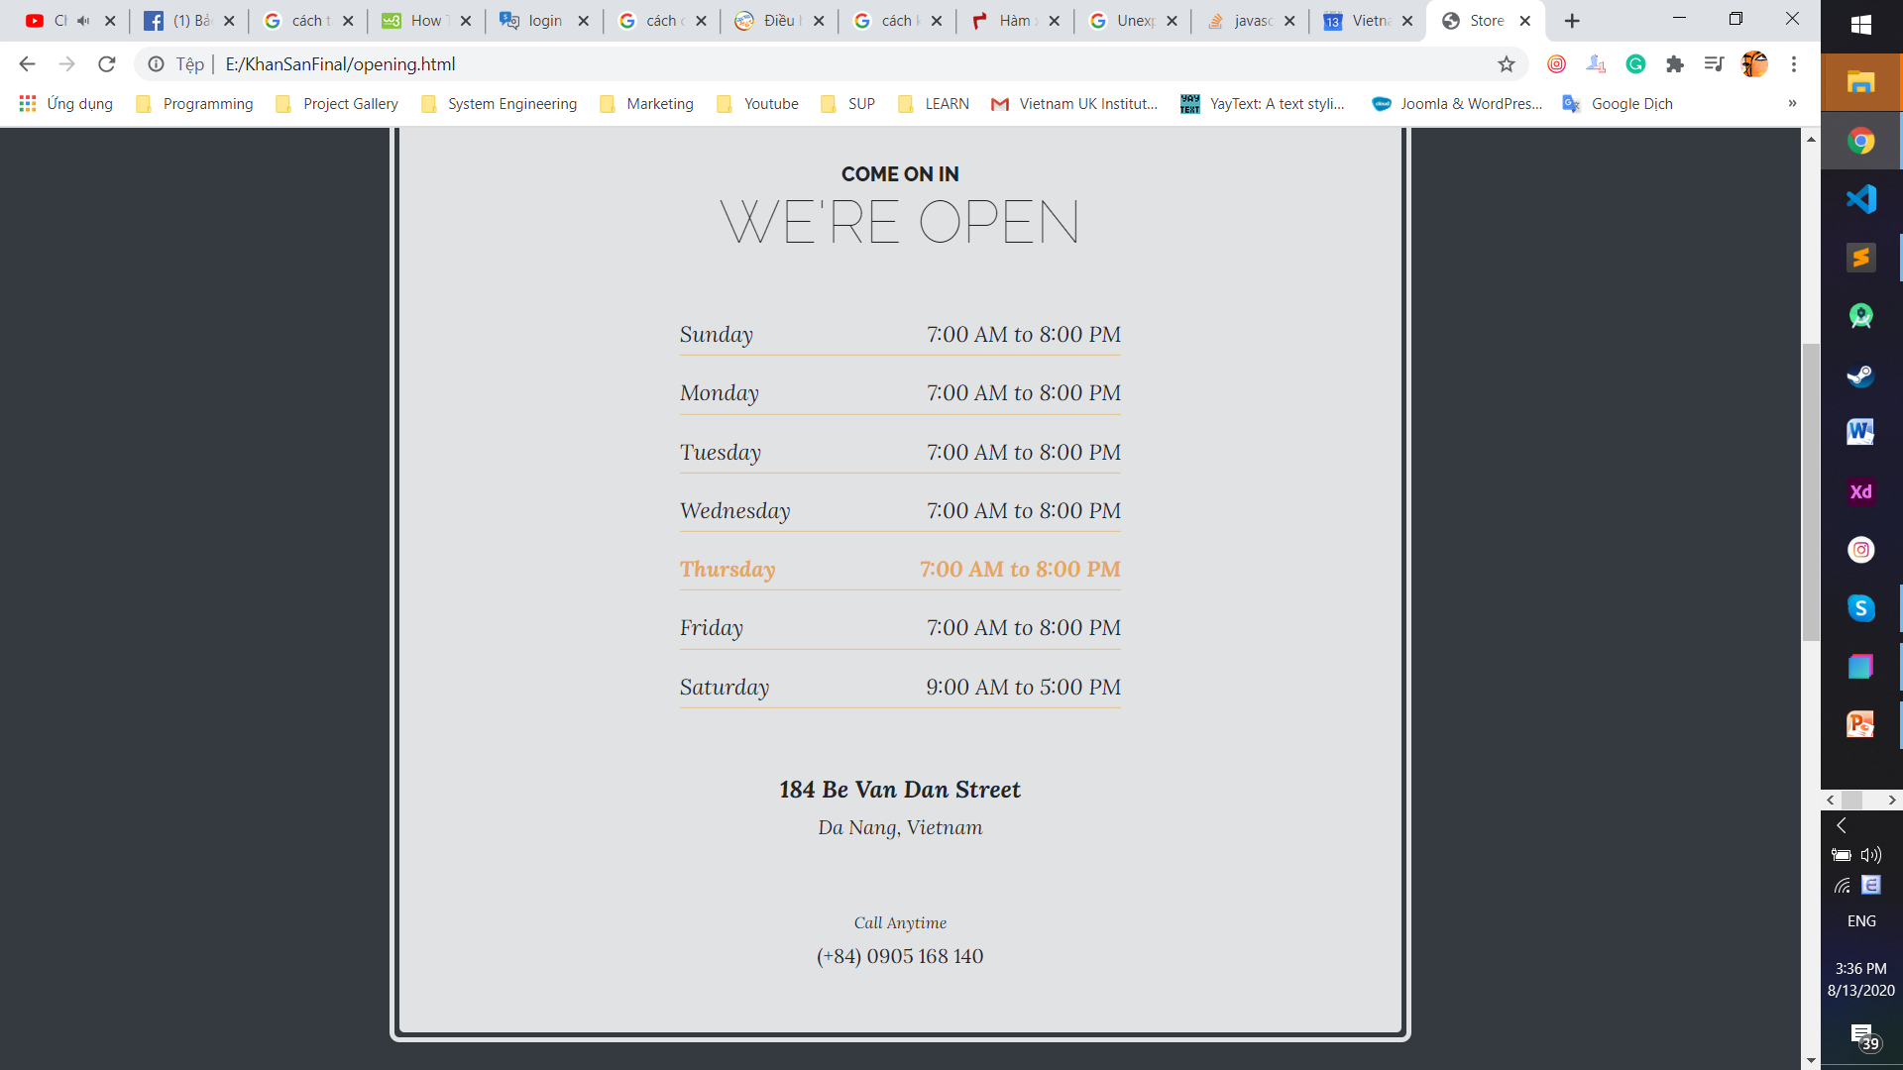
OPENING TIME PAGE

Slide 6
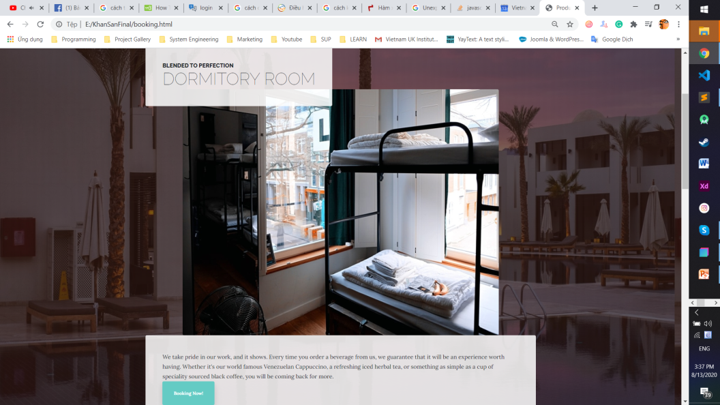
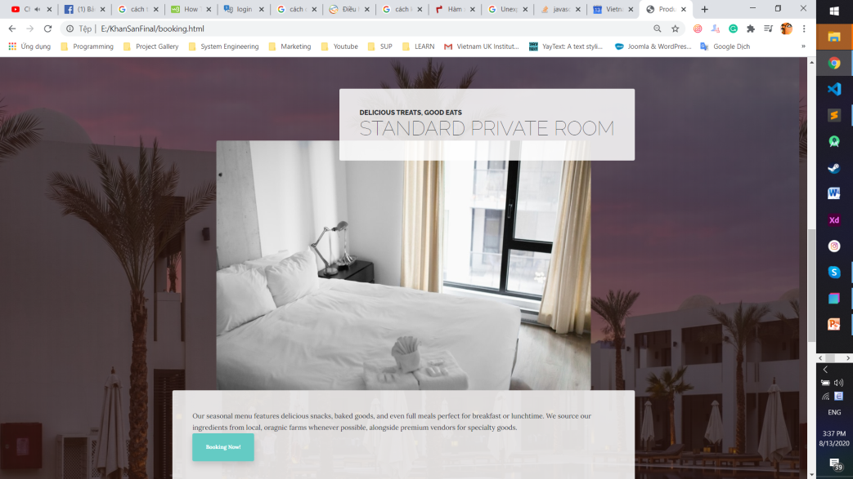
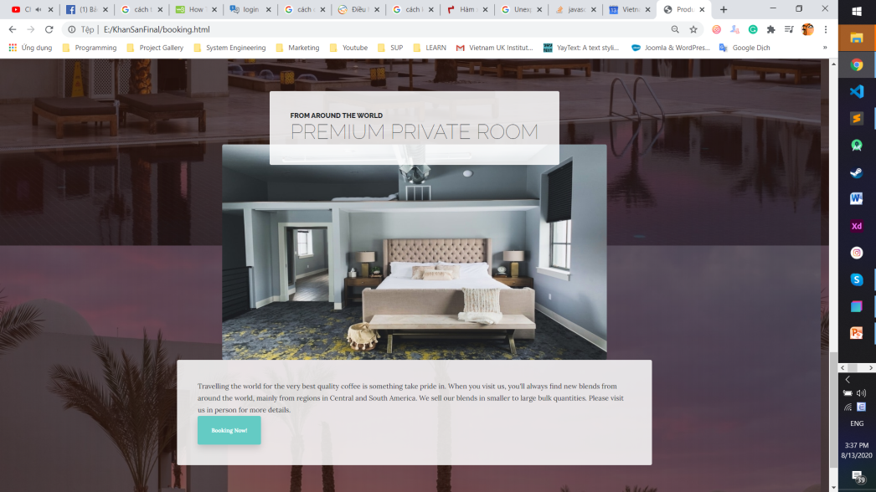
BOOKING PAGE

Slide 7
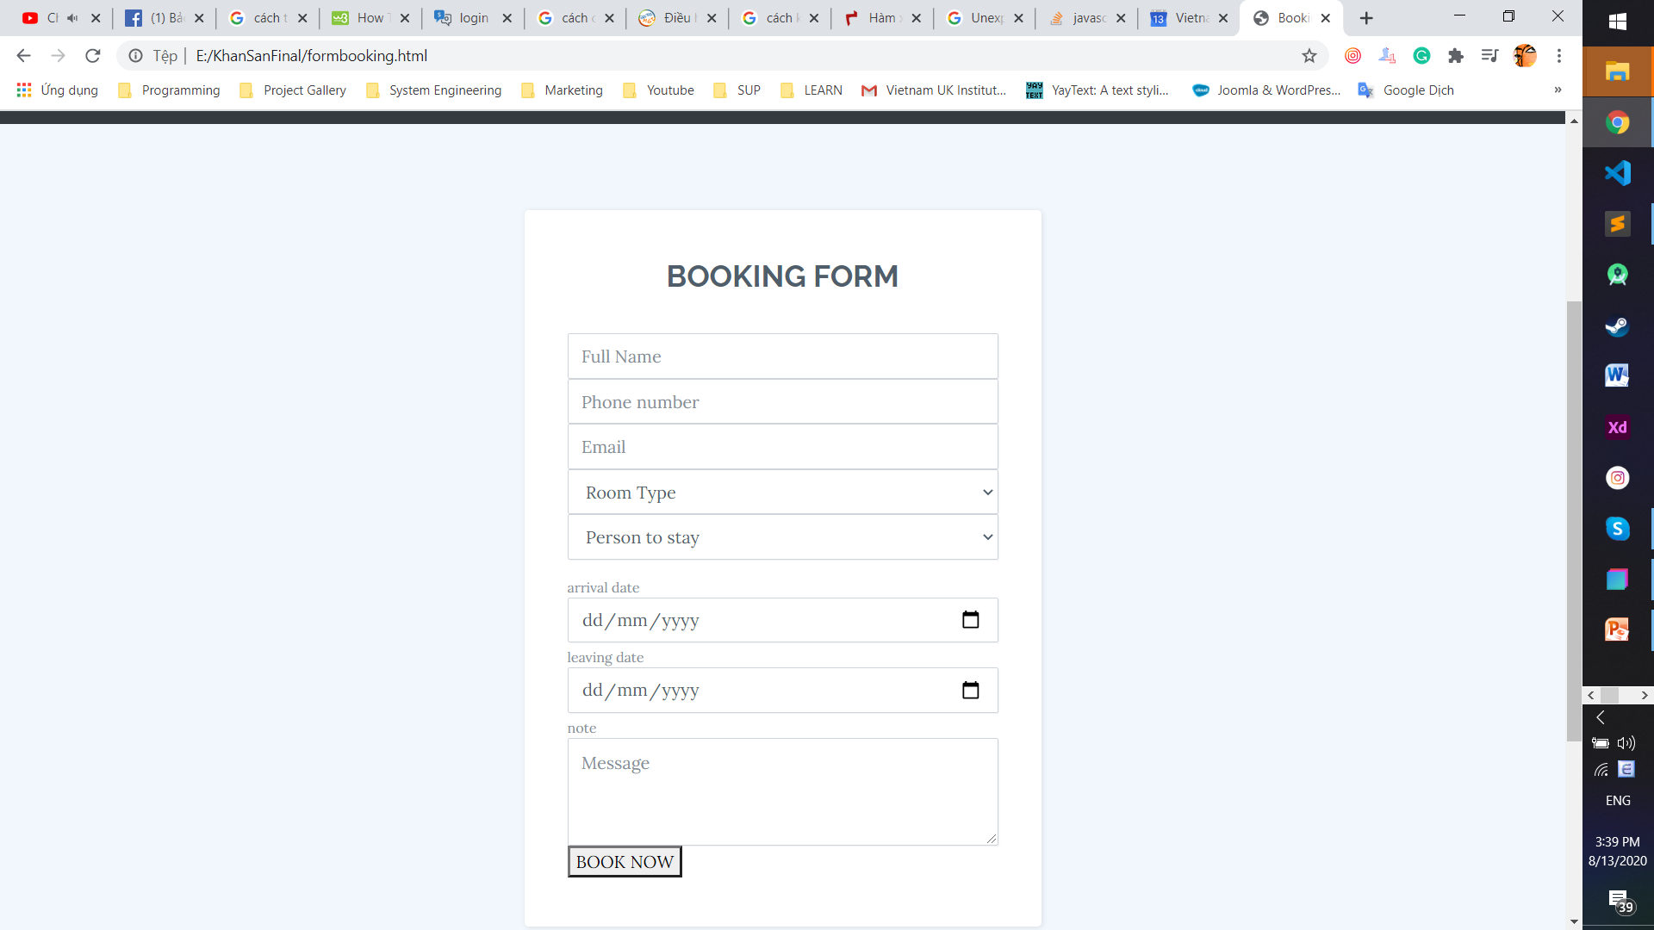
BOOKING FORM

Slide 8
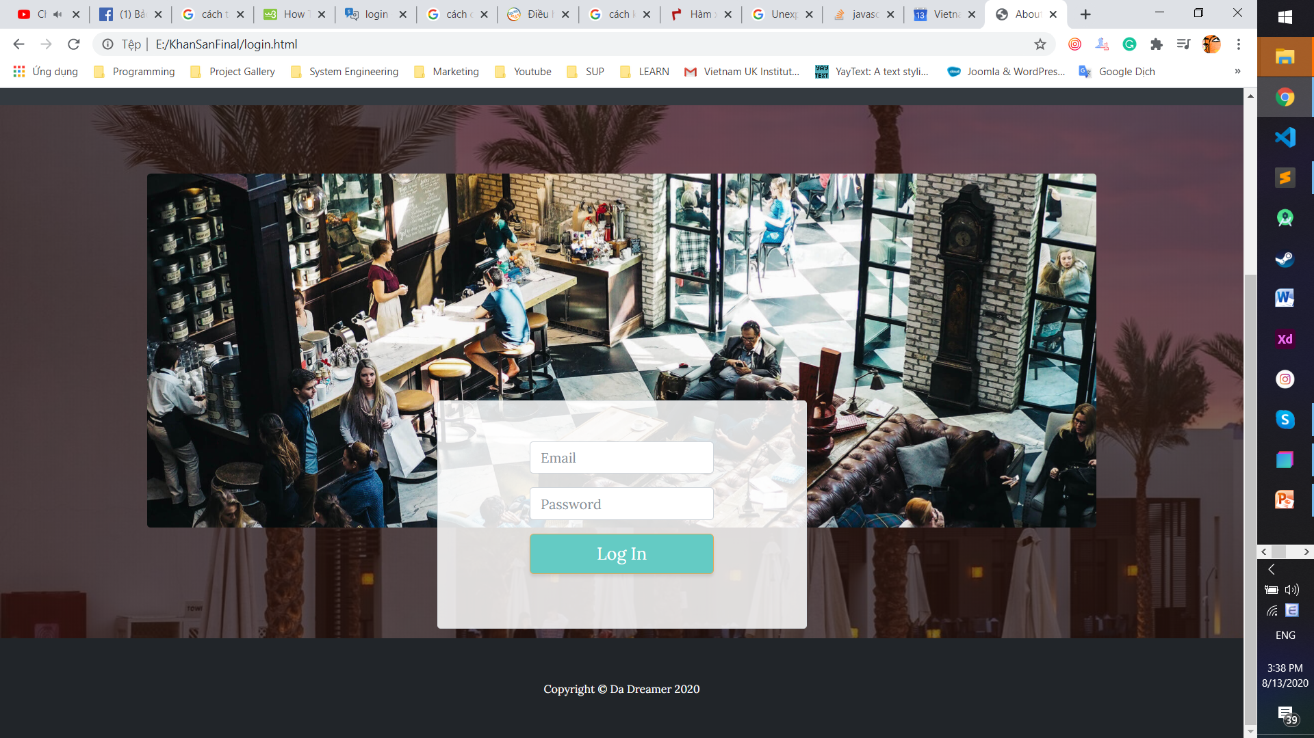
LOGIN PAGE

Slide 9
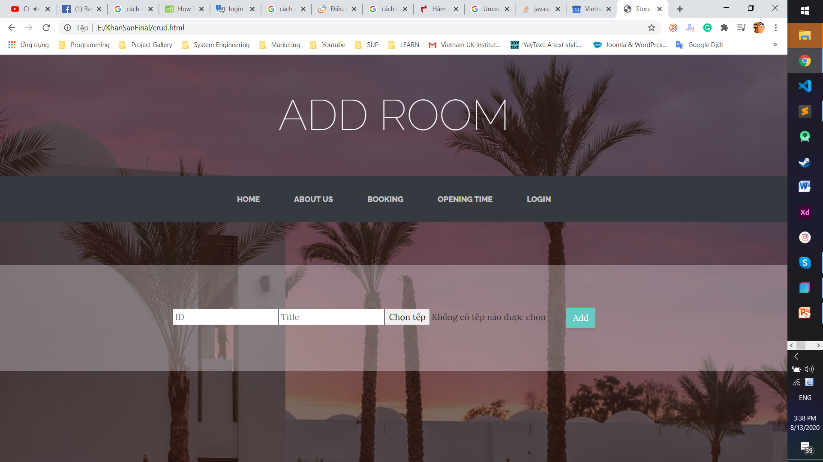
ADMIN PAGE

Slide 10
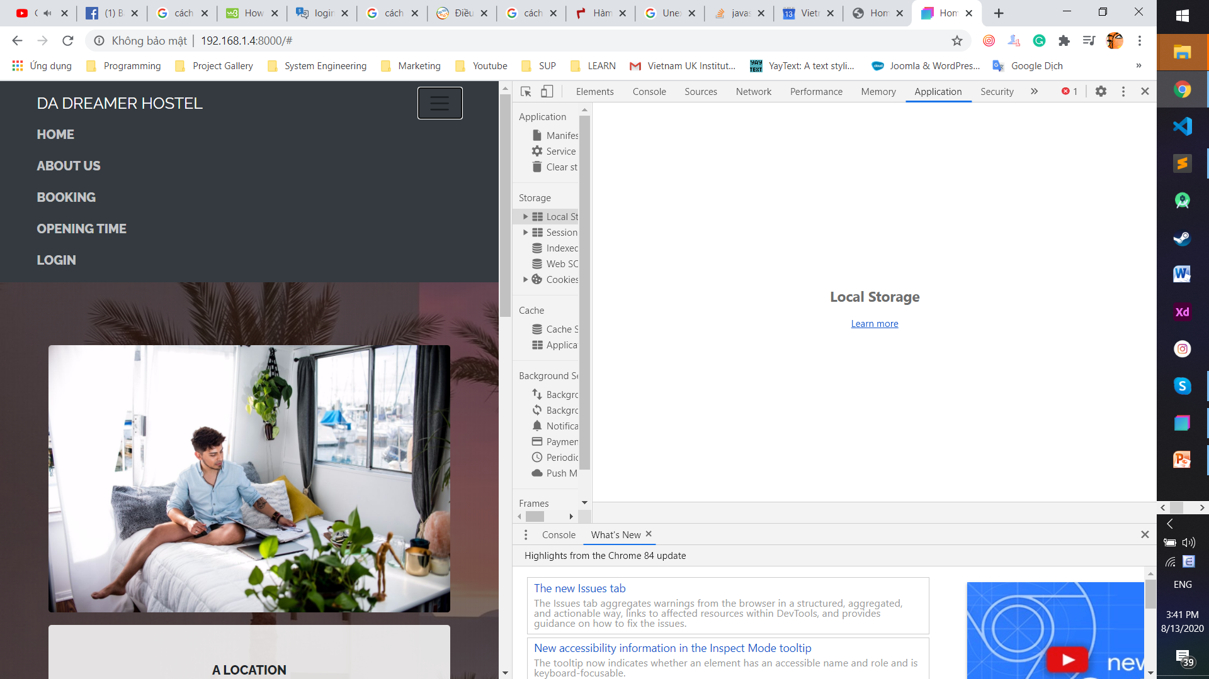
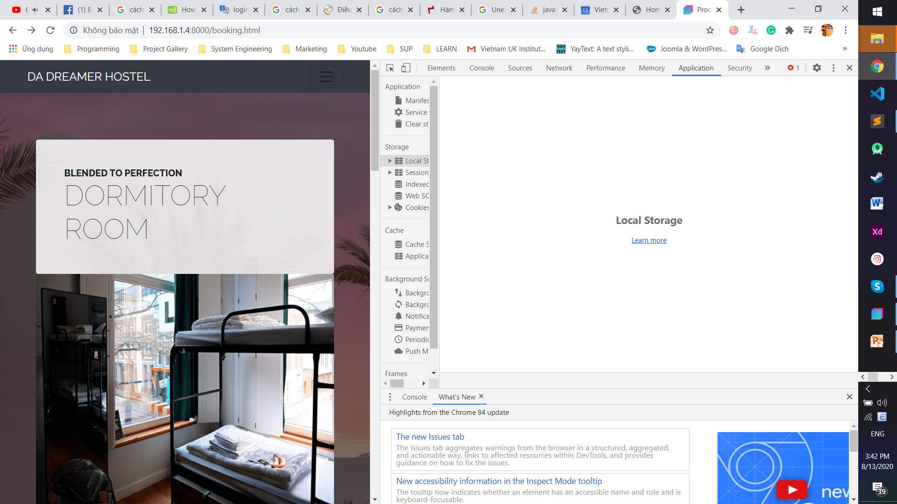
RESPONSIVE

